Slide 1
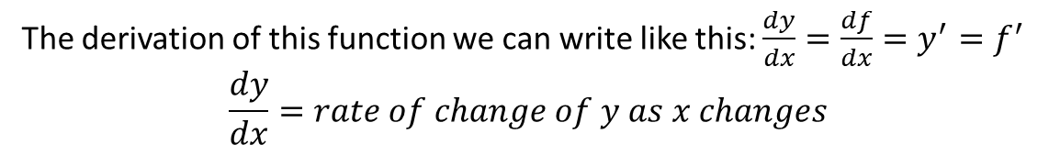
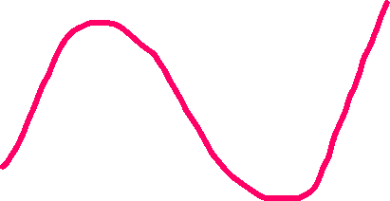
Calculus (Differentiation)
Y=f(x)
This is called a function in calculus
x
The derivation of this function we can write like this: $\frac{dy}{dx}=\frac{df}{dx}=y^{′}=f^{′}$ $$\frac{dy}{dx}=rate of change of y as x changes$$

Slide 2




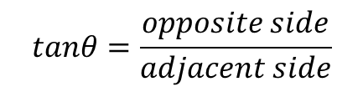
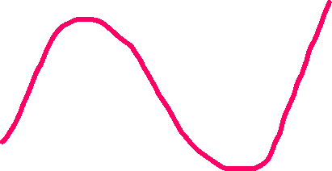


Opposite side
$$tanθ=\frac{opposite side}{adjacent side}$$
$$θ$$
Y=f(x)
Adjacent side
$$y_{2}$$
$$\frac{y_{2}−y_{1}}{x_{2}−x_{1}}=\frac{ΔY}{ΔX}=tanθ$$
$$y_{1}$$
x
$$x_{1}$$
$$x_{2}$$

Slide 3





Let’s find out the theta:
Y=f(x)
$$y_{2}$$
tangent
$$y_{1}$$
$$θ$$
x
$$x_{1}$$
$$x_{2}$$

Slide 4




Theta value will be:
Y=f(x)
Y=f(x)
$$90<θ<180=−ve$$
$$0<θ<90=+ve$$
tangent
tangent
$$θ$$
$$θ$$
x
x
Positive slope
Negative slope

Slide 5

$$if θ=0 then tan θ=tan 0=0$$
$$if θ=90 degree then tan θ=tan 90=∞$$
Y=f(x)
Y=f(x)
tangent
tangent
x
x

Slide 6

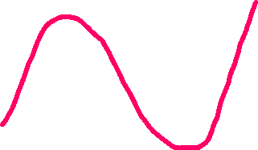
Y=f(x)
Formula of gradient descent:
$$x_{new}=x_{old}−lr∗slope$$
tangent
In this formula we can see, if the slope value is
Positive then we subtract some value from old
Value. So, the slope will be decrease an it come
Towards the down. If the slope value is negative
From the formula minus and slope value minus
Then it will be positive value. So, we add something
With the old value. So, slope value will be increase
And it will come towards the down.
Slope = -ve
Slope = +ve
Slope = 0
x

